Slide 1
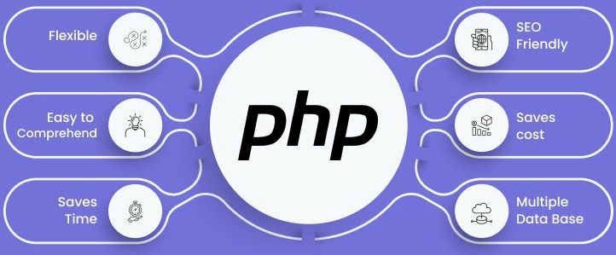

Slide 2
About today…
State Management
Cookies

Slide 3
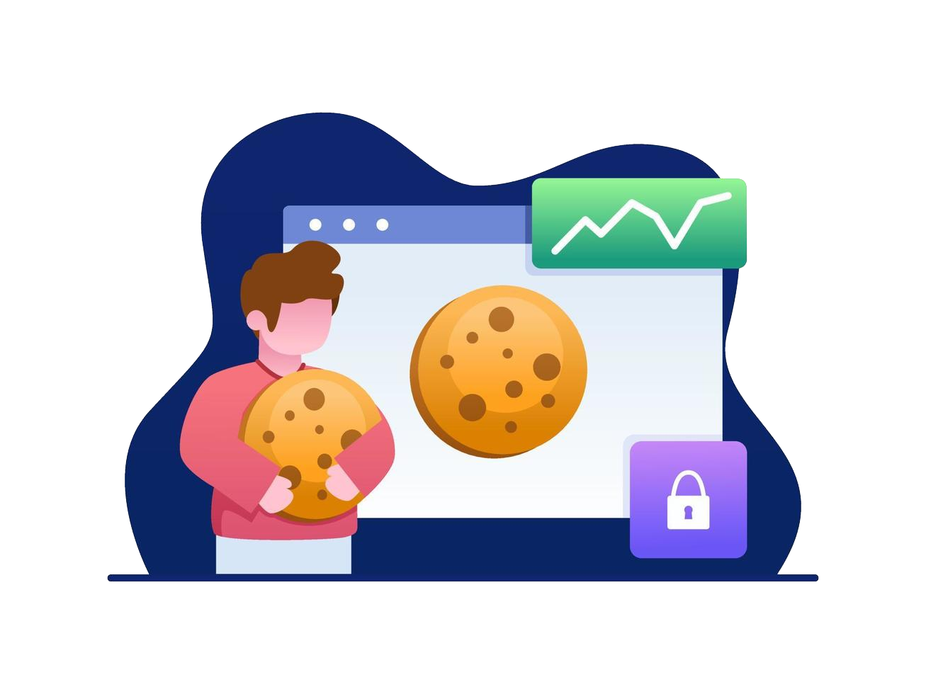
C O O K I E S

Slide 4
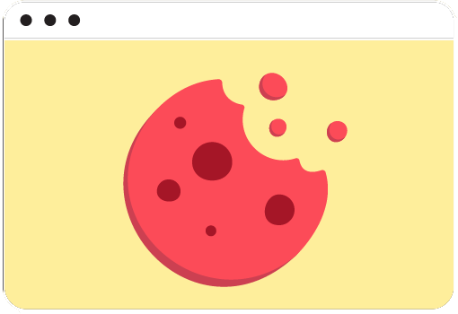
Introduction to Cookies
Definition
Small text files stored on the user's browser
Purpose
Used to store user-specific information for a specific
duration
Examples
Session tracking, user preferences, login details

Slide 5
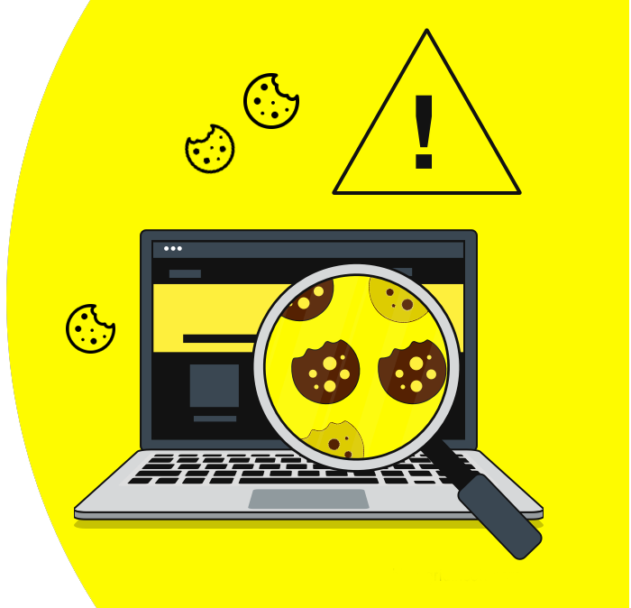
Why Use Cookies?
Persistent State
Maintain user state across multiple pages and sessions
Personalization
Customize user experience based on stored preferences
Tracking
Monitor user behavior for analytics and personalized content
Security
Store session IDs securely

Slide 6
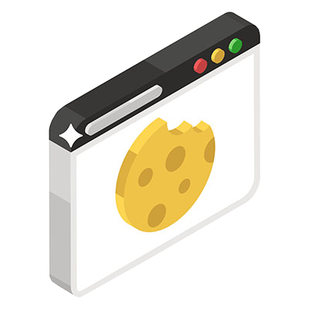
Setting Cookies in PHP
Syntax
setcookie(name, value, expire, path, domain, secure, httponly);
Parameters
Customize user experience based on stored preferences
name
The name of the cookie
value
The value of the cookie
expire
Expiry time in Unix timestamp (optional)
path
The path on the server (optional, default is "/")
domain
The domain that the cookie is available to (optional)
secure
Indicates if the cookie should only be transmitted over a secure HTTPS connection
httponly
When true, the cookie is accessible only through the HTTP protocol (optional)

Slide 7
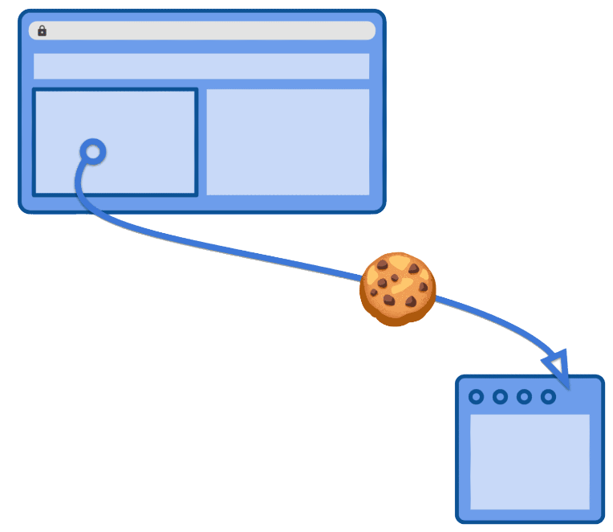

Example: Setting a Cookie
Content
The cookie named 'user' with the value 'John Doe' will expire in one hour

Slide 8
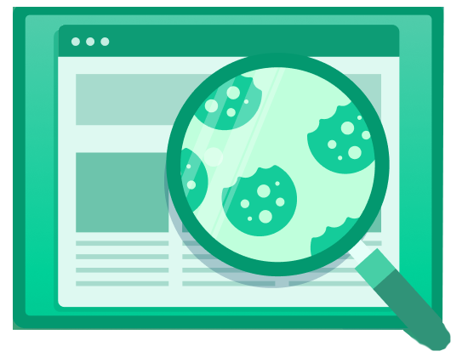
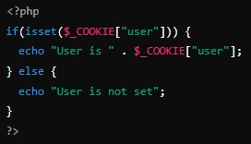
Retrieving Cookies
Accessing Cookies
Using the $_COOKIE superglobal array
Example
Explanation
Checks if the 'user' cookie is set and prints its value

Slide 9


Modifying and Deleting Cookies
Accessing Cookies
Using the $_COOKIE superglobal array
Modifying
Simply overwrite the cookie by setting it again with a new value
Deleting
Set the cookie with a past expiration time

Slide 10
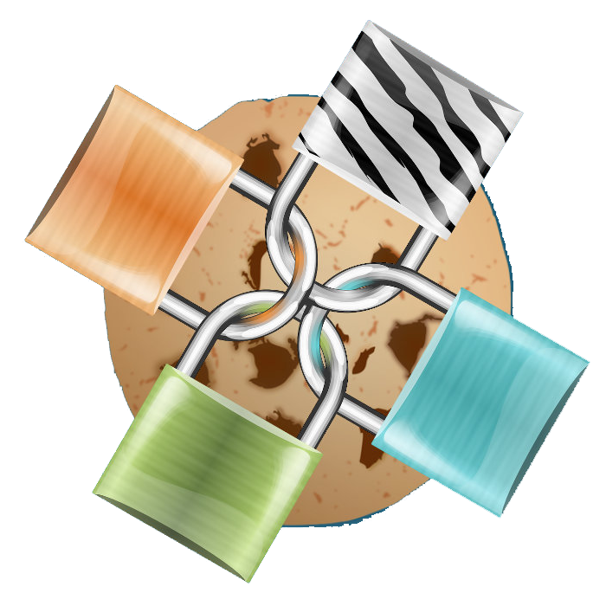
Cookie Attributes and Security
Secure Attribute
Ensures the cookie is sent over HTTPS only
HttpOnly Attribute
Prevents access to the cookie via JavaScript
true for secure and httponly ensures the cookie is secure and HTTP-only

Slide 11


Slide 12

What is a session in PHP?
A way to store data across multiple pages on the server
Which function is used to start a session in PHP?
session_start()
How do you store a value in a session variable?
$_SESSION["key"] = "value";
Which function is used to destroy all data associated with a session?
session_destroy()

Slide 13

Task 1
Practice starting a session, setting session variables, and accessing them

